Slide 1
NCH - PEDMATCH
Integration Overview, v1.0-draft
Last revised, 5/9/2016, ESK

Slide 2
Terminology
Collection Grouping ID (“CGID”)
Shared by specimens of a given type taken from a patient in one encounter/surgery/draw/etc.
Same CGID means specimens are “equivalent” from a PED-MATCH standpoint
Specimen messages sent to MATCHBOX will include the CGID
CGIDs will be “inherited” by the various aliquots/derivatives from the original specimens
Specimens obtained through follow-up requests by BPC (e.g., inadequate/insufficient received) will keep the original CGID if specimens are known to come from the same original encounter/surgery/block/etc.

Slide 3
Collection Grouping Examples
Scenario 1
First two specimens grouped together because attributes match (“equivalent” from PED-MATCH standpoint); New (shared) CGID
Third specimen was collected separately from first two; New CGID
Fourth specimen differs by type; New CGID
CGID=1234
CGID=1235
CGID=1236
Pt# 123, Blood,
Collected 10/15/16
Pt# 123, Blood,
Collected 10/15/16
Pt# 123, Blood,
Collected 10/30/16
Pt# 123, Tumor Tissue, Collected 10/15/16
time

Slide 4
Collection Grouping Examples
Scenario 2
First two specimens differ in collection date; Each receives a unique CGID
Third specimen—though arriving at the BPC days later—reuses the first specimen’s CGID since they are “equivalent” from a PED-MATCH standpoint
Late-arriving specimens (e.g., delays in shipping/accessioning)
Cases where BPC requests additional portion of existing specimen (e.g., inadequacy) and site is able to indeed provide more from that original specimen
CGID=1234
CGID=1235
CGID=1234
Pt# 123, Tumor Tissue, Collected 10/15/16
Pt# 123, Tumor Tissue, Collected 10/30/16
…time passes…
Pt# 123, Tumor Tissue, Collected 10/15/16
time

Slide 5
Collection Grouping Examples
Scenario 3
First two specimens differ in collection date; Each receives a unique CGID
Third specimen arrives at the BPC days later but does NOT reuse the first specimen’s CGID since they are not from the same collection and thus not “equivalent” from a PED-MATCH standpoint
Cases where BPC requests additional portion of existing specimen (e.g., inadequacy) but site is unable to provide more of the original specimen, instead substituting from another specimen/draw/etc.
CGID=1234
CGID=1235
CGID=1236
Pt# 123, Blood,
Collected 10/15/16
Pt# 123, Blood,
Collected 10/30/16
…time passes…
Pt# 123, Blood,
Collected 11/30/16
time

Slide 6
“Specimen Received” Integration Message
DIRECTION: Outbound from BPC to MATCHBOX
TIMING: Sent when new specimens of interest are detected in STARS
Specimen is accessioned under APEC1621
Patient is enrolled in APEC1621
Specimen type of Blood or Tumor Tissue
Accessioning paperwork QC is successful
CONTENT:
Technical Message Headers (msg_guid, msg_dttm)
List of specimens
PED-MATCH attributes (patient_id, collection_grouping_id, type, disease_status, study_id, received_ts, collection_ts)
Additional (troubleshooting) attributes (stars_patient_id, stars_specimen_id, stars_specimen_type, qc_ts)
Timestamps conveyed in GMT/ISO-8601

Slide 7
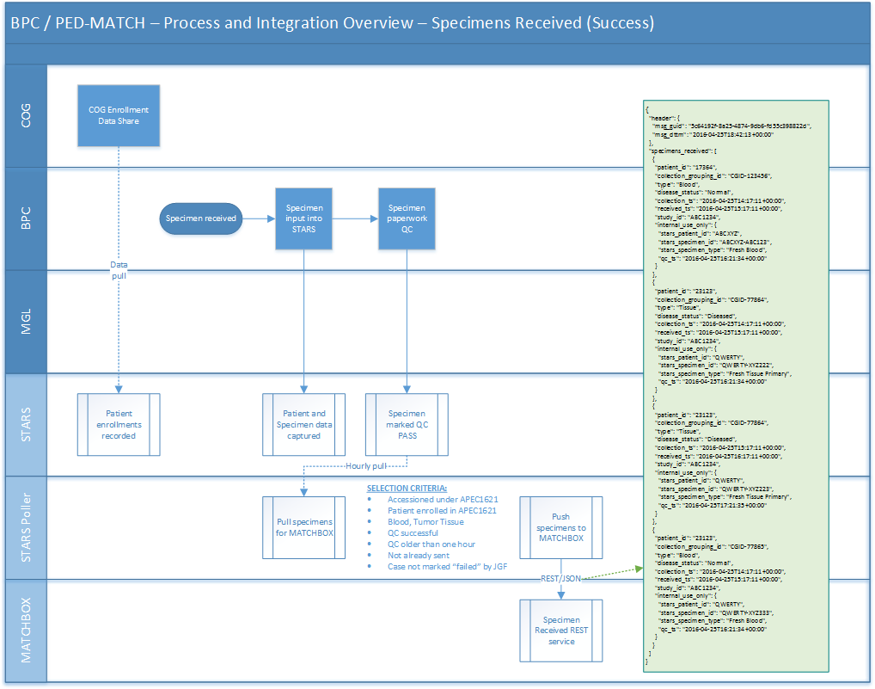

Slide 8
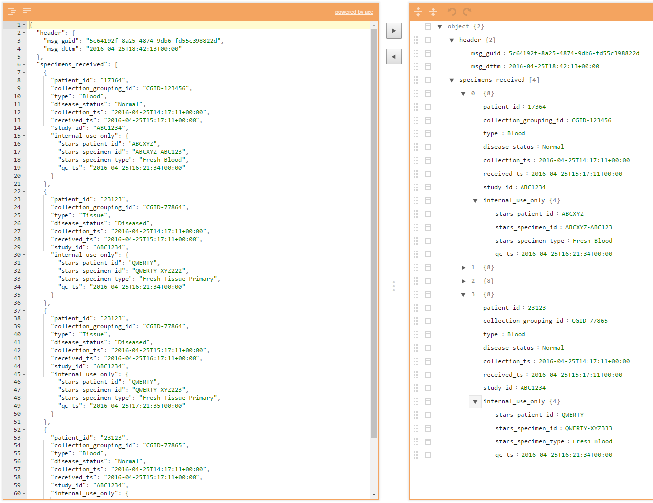
“Specimen Received” Integration Message
http://www.jsoneditoronline.org/?id=2bb98110923f6ffbed5df847737154b3

Slide 9
Terminology (continued)
Workflow Exception
Something that does not follow the happy path
Does not necessarily imply failure—could be informative
May be a patient-level or specimen-level issue
Workflow Exception Severity
“Advisement” = Correctable situation or status update
“Failure” = Non-correctable situation (with likely downside implications for patient’s involvement in Ped-MATCH)
Workflow Exception Details
Will include a discrete “exception_reason” from a pre-defined list (e.g., “path_not_concordant”); semantics still being defined—future draft will propose
May include a free-form textual “exception_notes” with additional details to help understand the context of the exception (e.g., “Specimen appears to have been contaminated”)

Slide 10
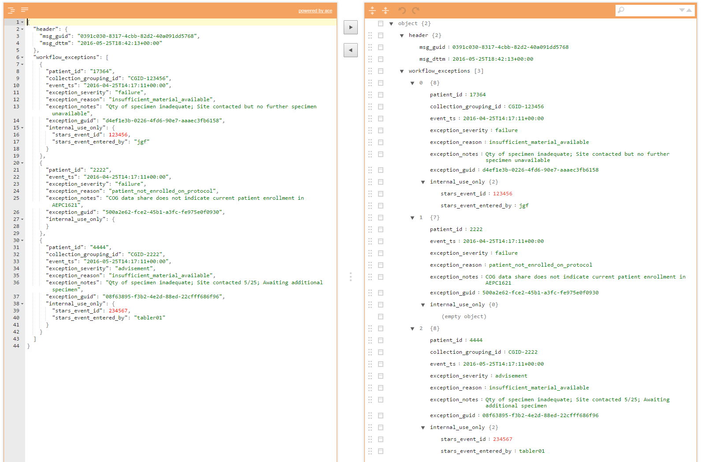
“Workflow Exception” Integration Message
http://www.jsoneditoronline.org/?id=8980b0e336c36ef69c6bd471f07f6c6d

Slide 11
Workflow Exception/Advisement Scenarios
(draft)
Specimen Adequacy Advisements
Insufficient Material
Incorrect/Unexpected Material
Requesting additional material
No further material available
Pathology Review Advisements
Pathology Not Concordant
Insufficient Tumor Present / High Necrosis
Extraction Advisements
Low Yield / QNS
Extraction QC Failure
General Laboratory Failure (catch all, e.g., contaminated specimen)
Patient Advisements
Patient Identity Mismatch
Patient Not Enrolled (based on enrollment data from COG data share)

Slide 12
To be continued…
Definition of specific attributes for grouping specimens for CGID derivation
Semantics and messaging scenarios for “specimen failed” messaging

Slide 13
Testing Screen Mock Ups
…scenarios for JGF…

Slide 14
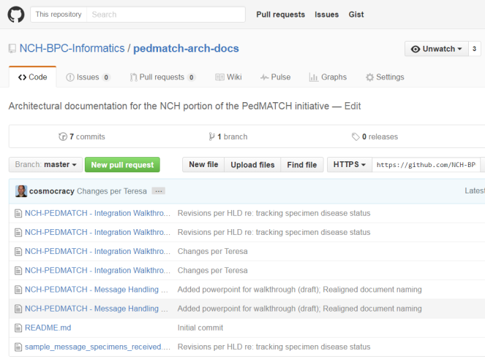
GitHub Repo
Public repository
Read-only access to NCH design documents, sample messages, etc.
Supports versions and branching
https://github.com/NCH-BPC-Informatics/pedmatch-arch-docs

